Slide 1
Global Office 365 Bootcamp – Barcelona, Spain Graph de principio a fin
Luis Mañez
Rubén Ramos

Slide 2
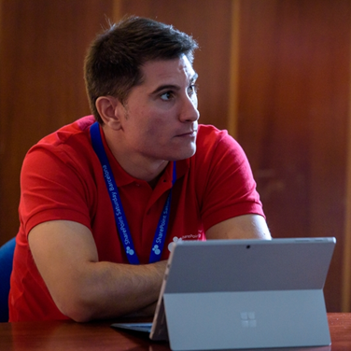
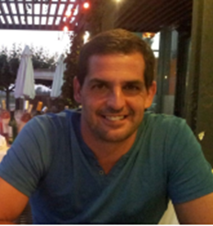


ABOUT US
Luis Mañez
Rubén Ramos
@luismanez
@rubenr79

Slide 3
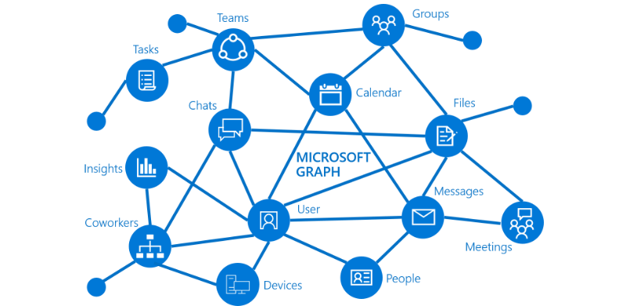
Qué es Microsoft Graph?

Slide 4
Azure AD v1 vs v2 endpoints
V1 endpoint
V2 endpoint
Portal | portal.azure.com | apps.dev.microsoft.com portal.azure.com (preview)
Accounts supported | Work / School | Work / School / Personal
Set of APIs | ALL (Graph, SharePoint, Intune, Skype…) | Only Graph API ALL
Multiple Platforms in App | No | Yes
Scopes | Resource | Request
Consents | Static | Dynamic
Multi-Tenant | Requires configuration | By default
Nuget Package | Microsoft.IdentityModel.Clients.ActiveDirectory | Microsoft.Identity.Client (pre-release)

Slide 5






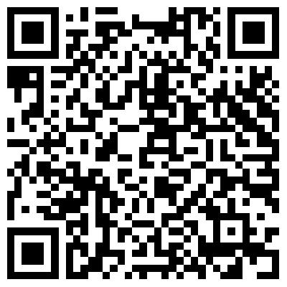
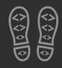
Enjoy the Bootcamp
https://github.com/CompartiMOSS/Global-Office-365-Developer-Bootcamp-BCN-18/tree/master/Azure

Slide 6

Call to action
(Recommendation to Bootcamp organizers and speakers: This slide can be used at the end of the Bootcamp to have attendees to fill online feedback form and recommendation for their ongoing learning and app development on Office 365 platform. Please keep the first three bullet points, you can update the last bullet point to be the user group or community that you are leading that you’d like attendees to join and learn more. Please keep the first feedback bullet point at the top and feel free to re-arrange the rest of bullet point orders. Thanks.
Share your feedback on Bootcamp at https://aka.ms/o365devbootcampfeedback
Join Office 365 developer program https://dev.office.com/devprogram to leverage all resources for Office 365 development learning
Build applications on Office 365 platform
Attend MVP led local community events to continue learning on Office 365 development

